Slide 1
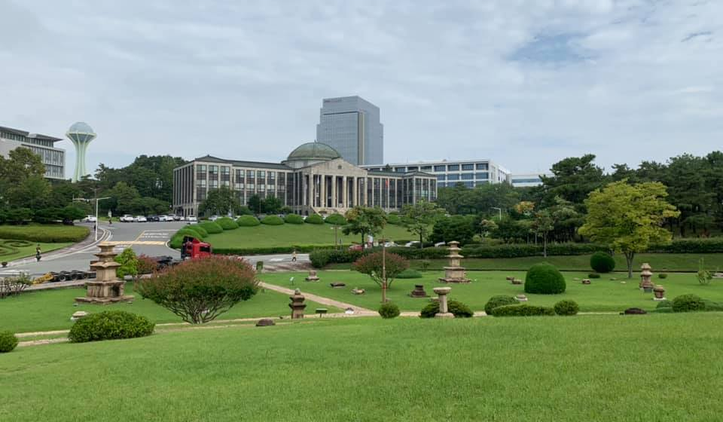
컴퓨팅사고와 SW코딩 2nd week
안병준 coolbrise@knu.ac.kr

Slide 2
Drive to Survive
https://youtu.be/WoFpyFL8E7s
8 essentials to become a better coder
Code to Survive / Succeed

Slide 3
For those who didn’t attend the first lecture.
Fill out the survey; You can find the link at LMS Announcement https://forms.gle/sQApQRegFV6y7ysH7
Fill out the PowerPoint file to tell me who you are; You can find the template file at LMS Repository; Send it to me via email.
Please refer to Toastmasters slide of the visual aids from the first lecture if you want extra points at Attitude criteria.
Please feel free to contact me during the break if you have any questions.

Slide 4
Assignment #1
Go to the library and borrow a Python book; And then send the picture of it to me via email.
Install any Python development tool on your laptop or desktop or other PC; And then send the picture of it to me and the name of the Python development tool via email.
Choose and solve “at least” 5 questions from Chap. 1 Exercise; Submit the result via email.

Slide 5
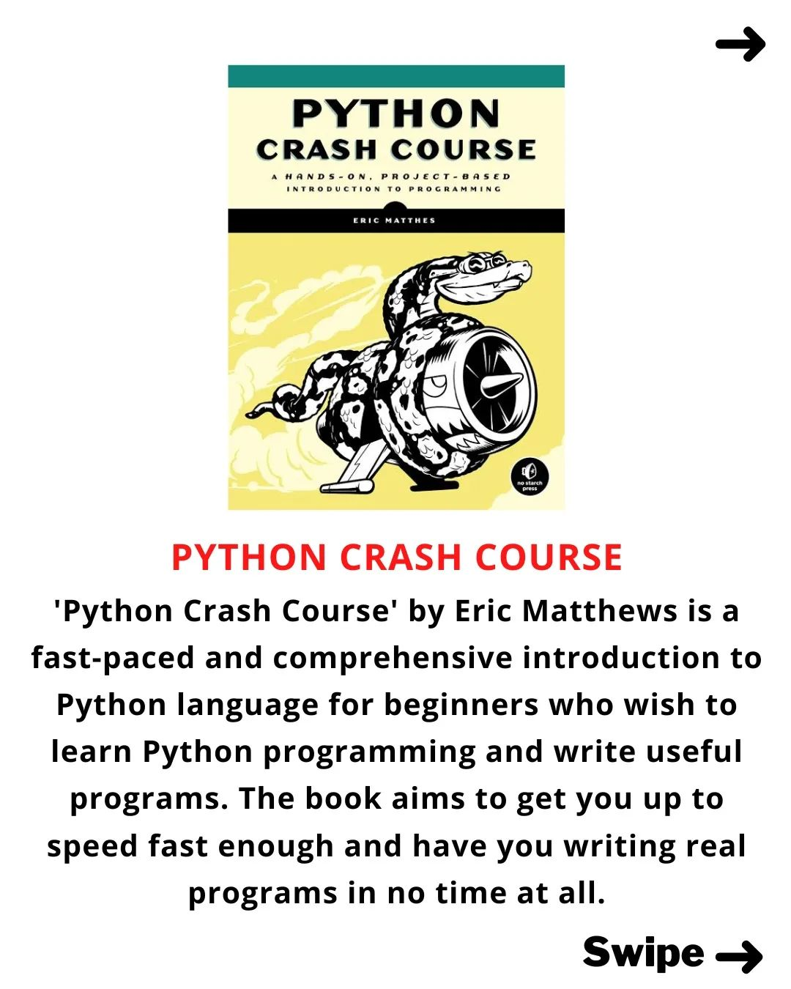
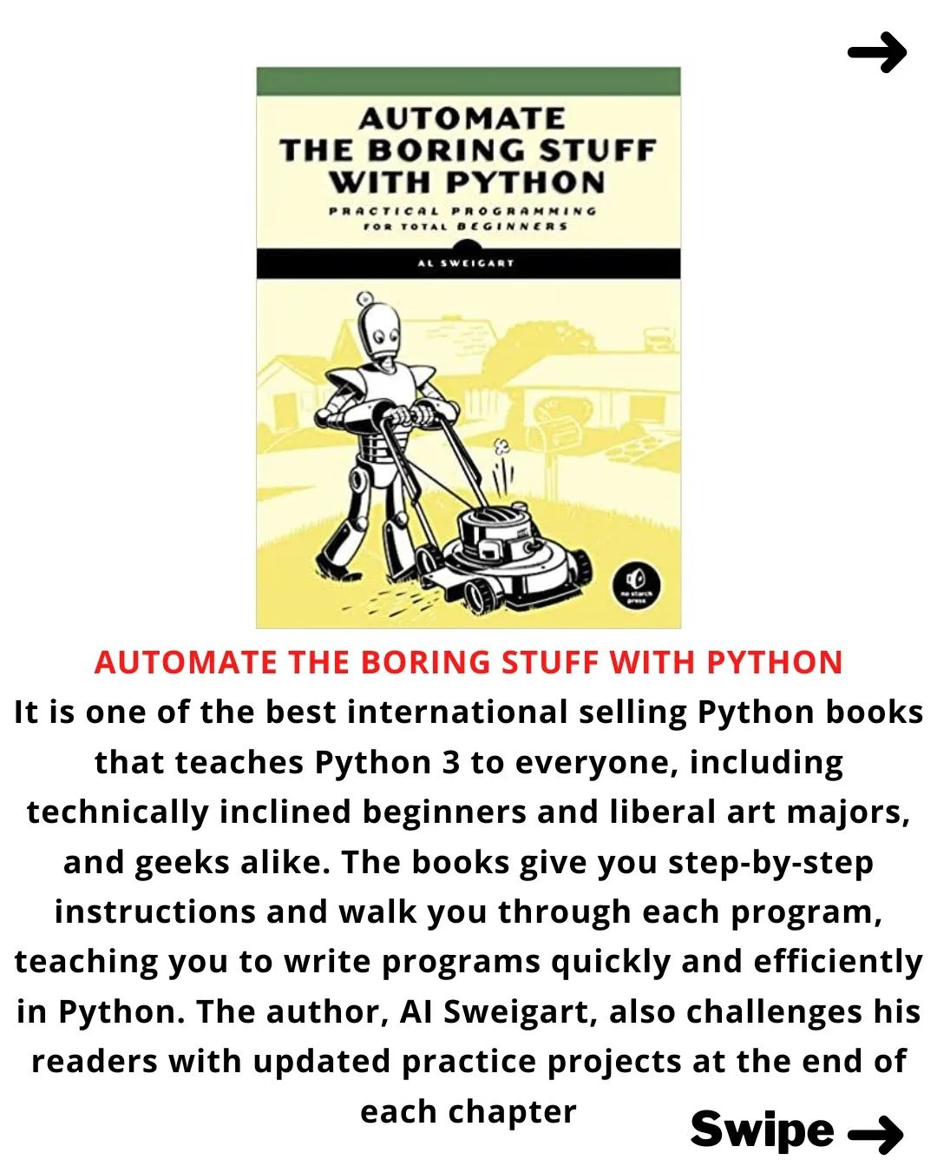
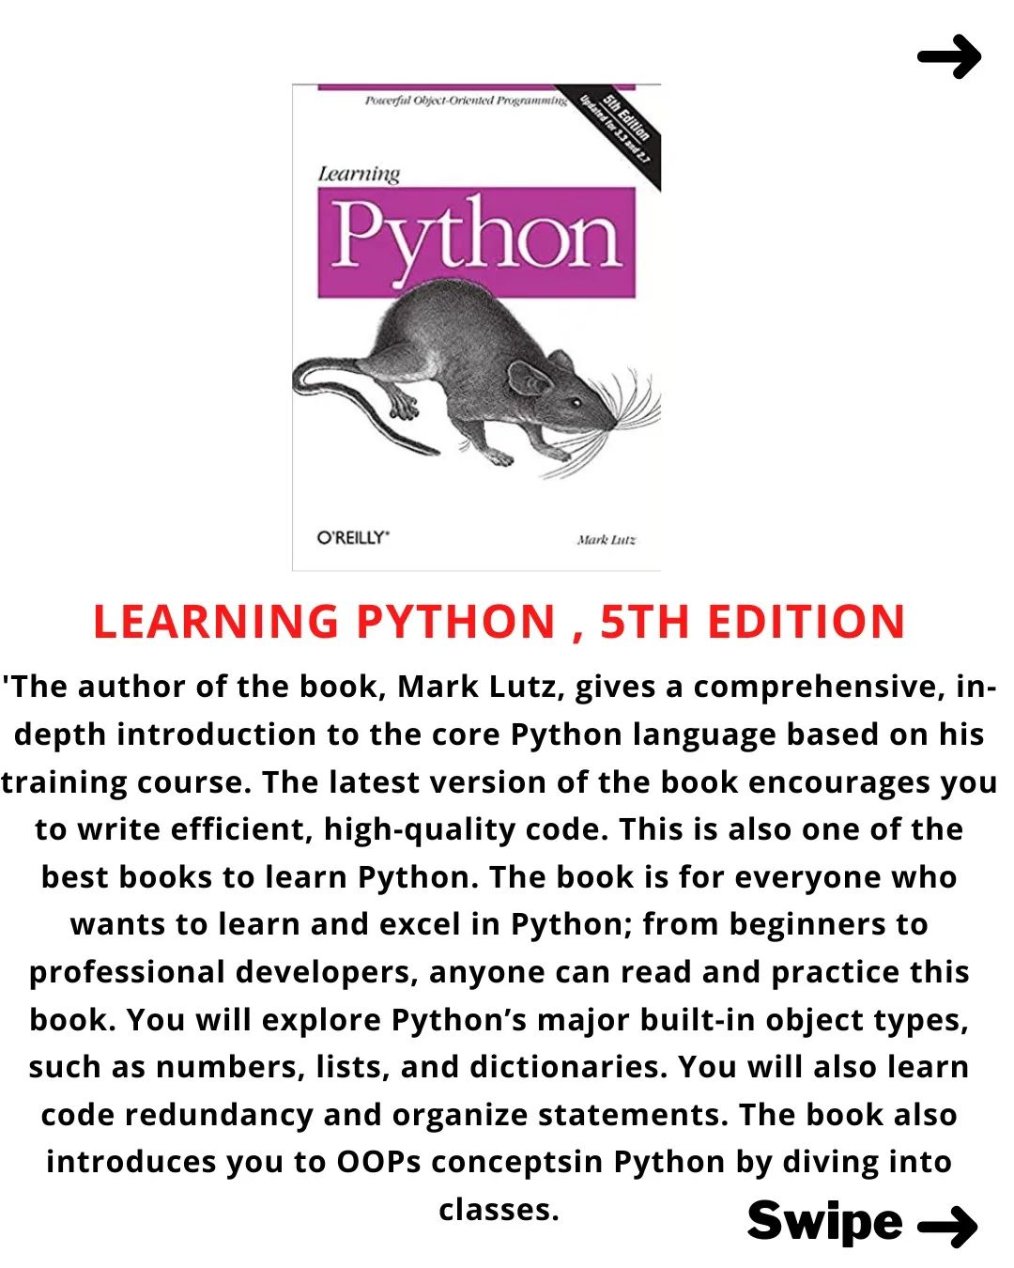
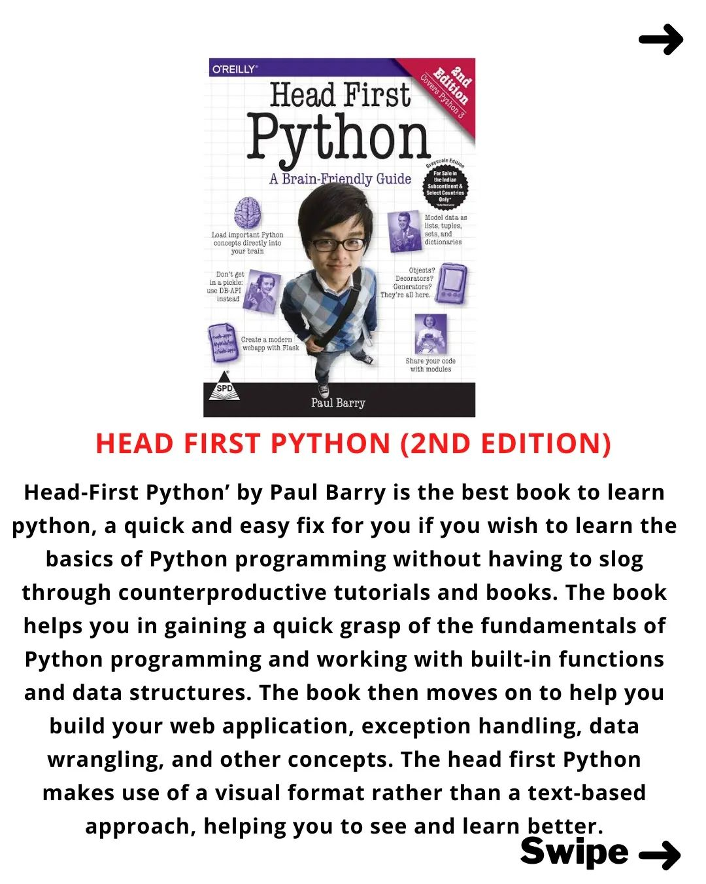
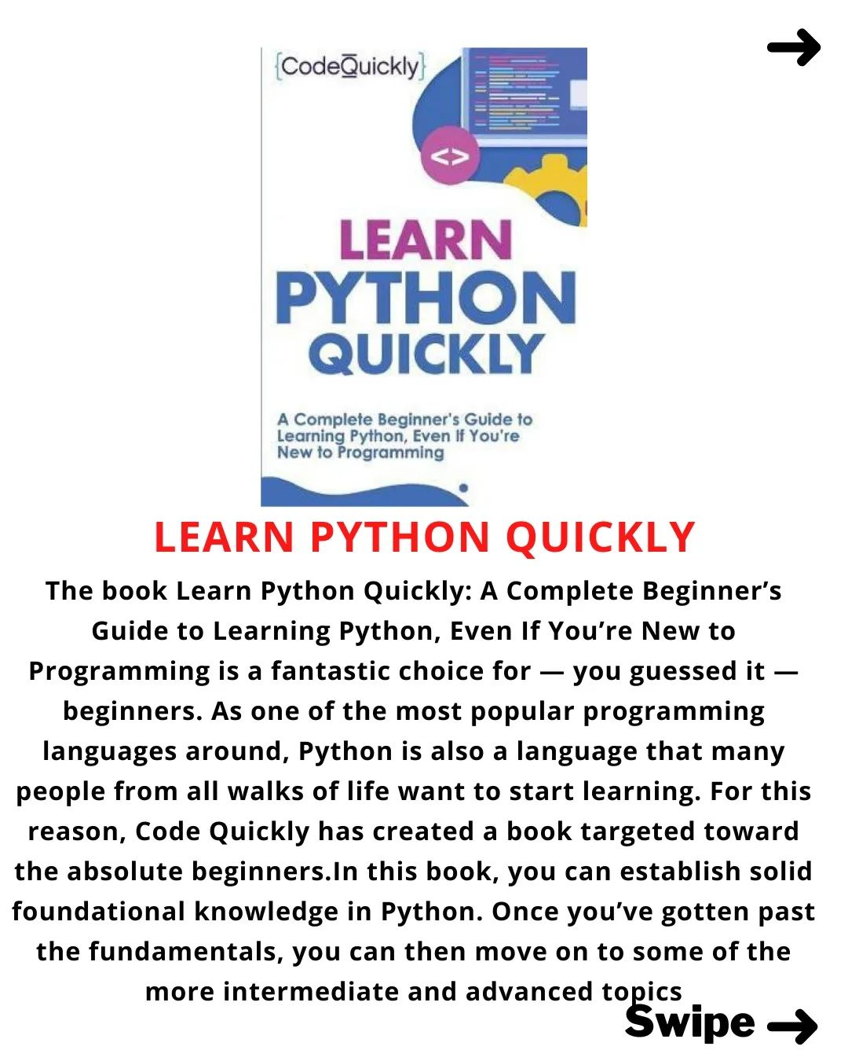
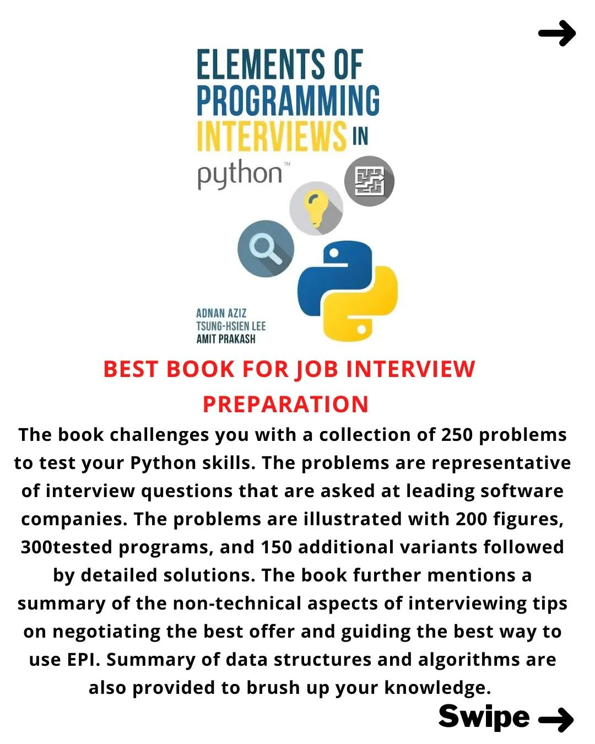
https://www.instagram.com/p/CiMTBlVriAH/?igshid=YmMyMTA2M2Y=

Slide 6
Tips for writing professional emails
Display name
Mail footer

Slide 7
Python IDEs
IDLE
PyCharm
Visual Studio Code
Anaconda
Jupyter Notebook
Google Colab
Top 10 Python IDEs in 2022

Slide 8
Ice-breaking
During the break time, the group of the first lecture get together.
Appoint the representative of your group. The previous one cannot take the role.
The theme : how to make ramen tasty.
Each group’s representative will have 1 to 2 minutes to present the group’s recipe.
Which group do you think the best?

Slide 9


Slide 10
Variable & Operators
https://docs.python.org/3/tutorial/index.html
Chapter 2 of the main textbook
print()
variable
type()
string
operators
comments
input()

Slide 11


Slide 12
2022 spring semester mid-term exam
문자열 foo’bar 을 표시하는 유효한 방법을 모두 고르세요.
"""foo'bar"""
'foo''bar'
"foo'bar"
'foo\'bar'
‘foo'bar'
아래의 실행 결과를 기록하세요.
>>> a = ~9 >>> b = 9
>>> print(a+b)

Slide 13
Google Search
https://support.google.com/websearch/answer/134479?hl=en
2022 spring semester mid-term exam
Jupyter Notebook 관련한 PDF 파일만 검색하려고 한다. 구글 검색방법을 기술하세요.
isinstance() 함수의 사용법을 https://stackoverflow.com 에서만 검색하려고 한다. 구글 검색방법을 기술하세요.

Slide 14


Slide 15
Git & GitHub
Git
GitHub
GitLab
BitBucket
School of Computer Science and Engineering

Slide 16
English study
Language Reactor
https://www.languagereactor.com/
https://missing.csail.mit.edu/
If you want to share your own way to study English, don’t hesitate to share it with the colleagues and me as well.

Slide 17
Assignment #2
Submit all the lab results to me via email.
Create GitHub account and let me know about it via email.
Master the Python IDE you’d like to leverage for this semester.
Study MarkDown
https://colab.research.google.com/notebooks/markdown_guide.ipynb
https://youtu.be/kMEb_BzyUqk
Refer to the appendix of the main textbook, which is now on LMS Repository.
Choose and solve “at least” 5 questions from Chap. 2 Exercise; Write the codes with MarkDown; Submit Jupyter Notebook file via email.

Slide 18
Announcement
A special seminar is being prepared.
Topic : Open Source S/W & community
Date : Sept. 29th Thursday
Time : 4:30pm ~ 6:00pm
Lecturer : Tommy Lee
Subject to change upon the lecturer’s schedule.

Slide 19
Further Studies
Familiarize yourself with python.org
https://wiki.python.org/moin/BeginnersGuide
Follow the accounts at Instagram
https://www.instagram.com/p/Ch_Txtirbu9
https://www.instagram.com/p/ChuirMxv-ls
Real Python
https://realpython.com/
Be a community leader
https://youtu.be/7i3UOP43-3o
Watch a movie
https://www.imdb.com/title/tt4846340/

Slide 20
Books for the aggressive students
2nd week: 오픈 소스로 미래를 연마하라
1st week: 히트 리프레시

Slide 21
“Sometimes it is the people no one can imagine anything of who do the things no one can imagine.”
– Alan Turing

